Slide 1

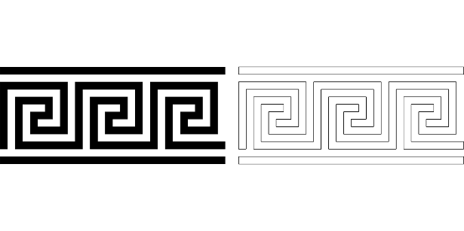
SYLLABLES AND WORD STRESS
Single vowels can constitute a syllable by itself: e.g. α-έ-ρας, Ι-ω-α-κείμ
On the other hand, one or more consonants cannot constitute a syllable without a vowel
Vowel digraphs (αι, οι, υι, ει, ου), spurious diphthongs (όι, όη, άι, αη, ια, υα, εια, οια) and combinations (αυ, ευ) are counted as a single vowel and are never taken separately: e.g. αί-μα, αη-δό-νι, πά-πια
Modern Greek (GRE1001) | Jacopo Mosesso | VIT University, July 2022

Slide 2
SYLLABLES AND WORD STRESS
4. A single consonant positioned between two vowels (or at the beginning of a word, followed by a vowel), forms a syllable with the second vowel (the one that follows): e.g. έ-λα, κα-πέ-λο
5. Two consonants positioned between two vowels (or at the beginning of a word, followed by a vowel) form a syllable with the second vowel (the one that follows) only if there are existing Greek words that start with that combination of consonants: e.g. κά-στα-νο (there are Greek words starting with στ, like for instance the word στάση, therefore the syllable στα can be formed without separating σ and τ)
Modern Greek (GRE1001) | Jacopo Mosesso | VIT University, July 2022

Slide 3
SYLLABLES AND WORD STRESS
Three or more consonants positioned between two vowels (or at the beginning of a word, followed by a vowel) form a syllable all together with the second vowel (the one that follows) only if there are existing Greek words that start with that combination of consonants (or at least with the first two of them):
e.g. κά-στρο (there are Greek words starting with στρ, like for instance the word στροφή, therefore the syllable στρο can be formed without separating σ, τ and ρ);
e.g. ε-χθρός (there are Greek words starting with χθ, like for instance the word χθες, therefore the syllable χθρός can be formed without separating χ and θ).
Modern Greek (GRE1001) | Jacopo Mosesso | VIT University, July 2022

Slide 4
SYLLABLES AND WORD STRESS
Otherwise, the consonant cluster is broken down, and the first consonant of the consonant cluster is included in the previous syllable:
e.g. άν-θρω-πος (there is no Greek word that starts with the combination of νθρ, therefore ν is separated from θρ: ν is included in the previous syllable άν, while θρ are forming the syllable that follows, i.e. θρω)
Modern Greek (GRE1001) | Jacopo Mosesso | VIT University, July 2022

Slide 5
SYLLABLES AND WORD STRESS
Same-consonant couples (γγ, λλ, ρρ, σσ etc.) are always split in two different syllables (e.g.: άλ-λος, θάρ-ρος,φεγ-γά-ρι)
Consonant digraphs, with the exception of γγ (μπ, ντ, γκ, τσ, τζ) are never split (e.g.: κα-μπά-να, πα-γκά-κι, πά-ντο-τε)
As a general rule, the lateral λ, trill ρ, nasal μ and ν are always separate from the consonant that follows (except, of course, the combination of μ and π and the combination of ν and τ). E.g.: άρ-μα, άμ-βω-νας, έν-ση-μο.
Modern Greek (GRE1001) | Jacopo Mosesso | VIT University, July 2022

Slide 6
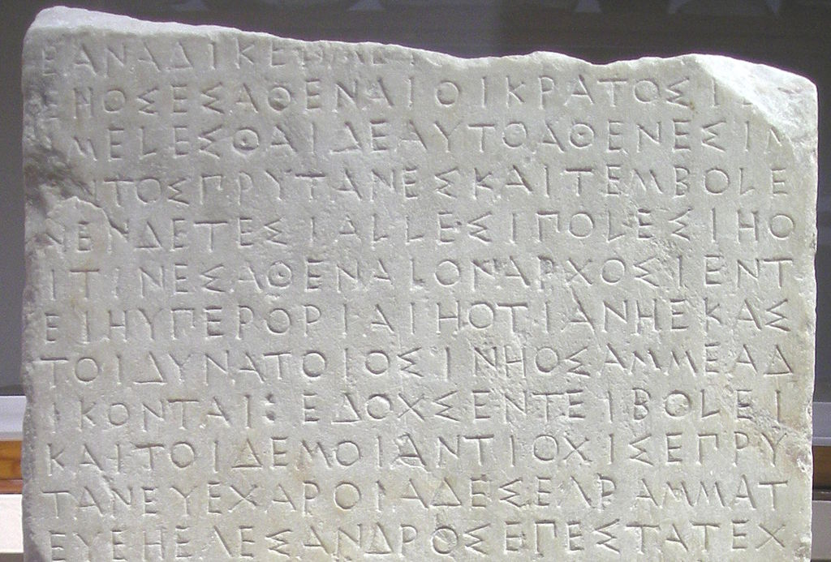
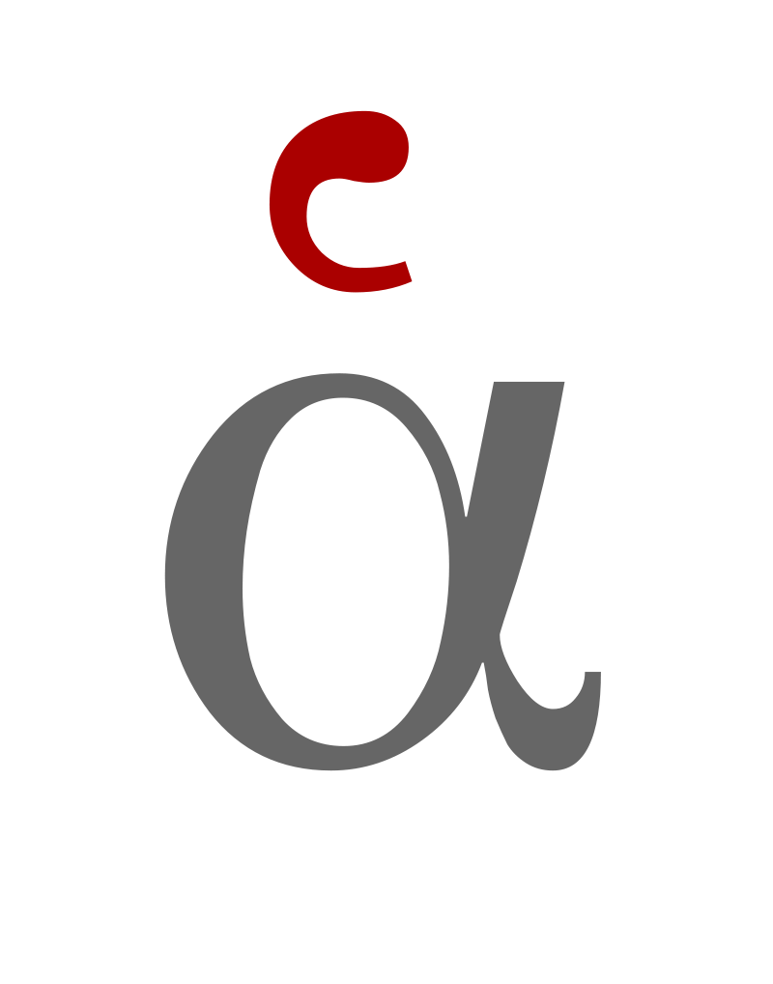
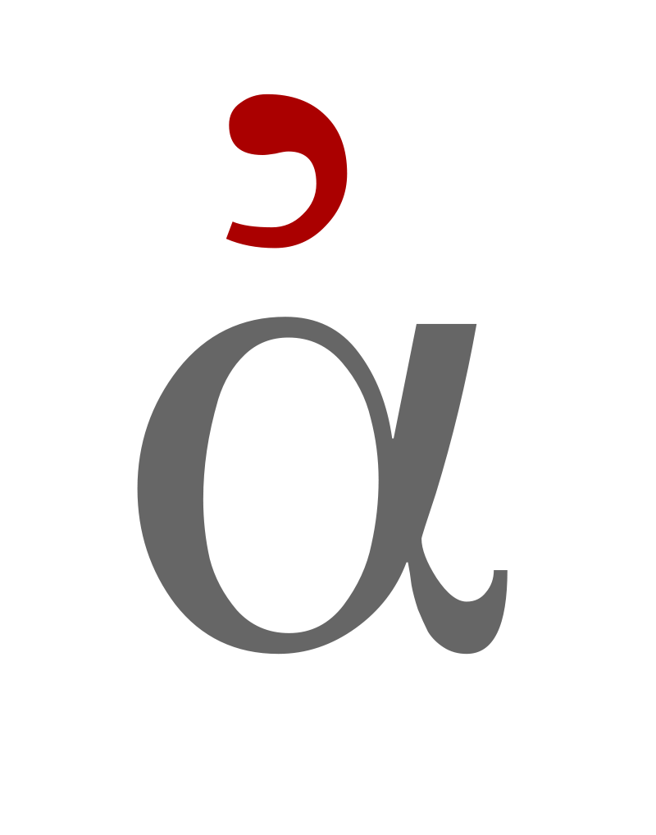
8th – 5th century BC → CAPITALS
Classical Period (5th and 4th century BC) → Introduction of rough and smooth breathings (η is pronounced as a long /ɛː/)
SOME HISTORY
Modern Greek (GRE1001) | Jacopo Mosesso | VIT University, July 2022

Slide 7
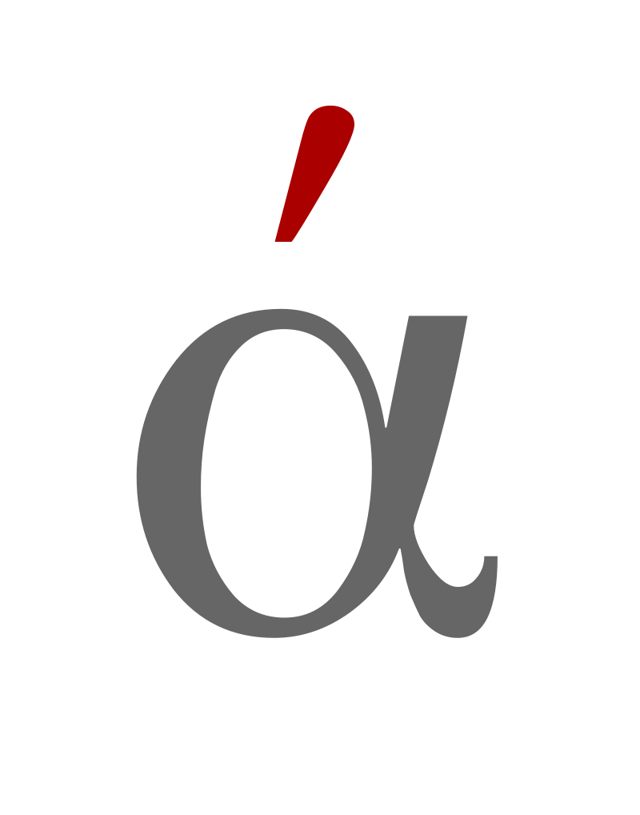
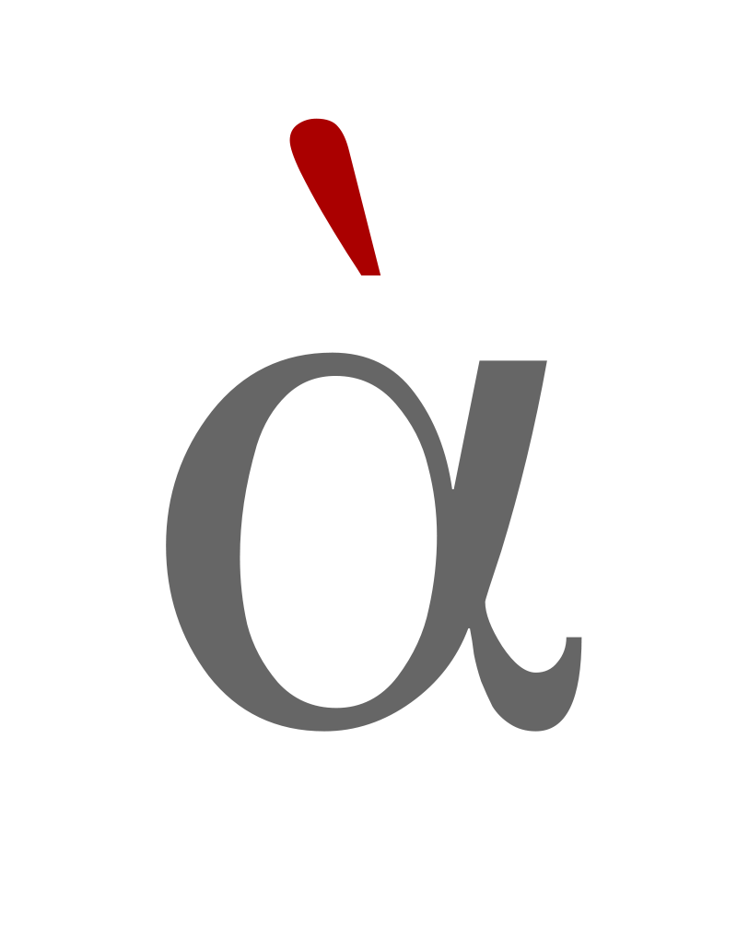
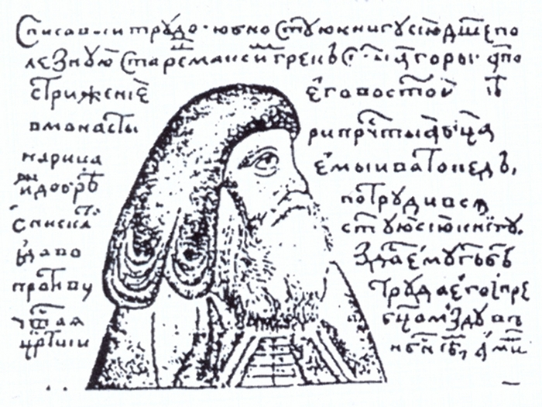
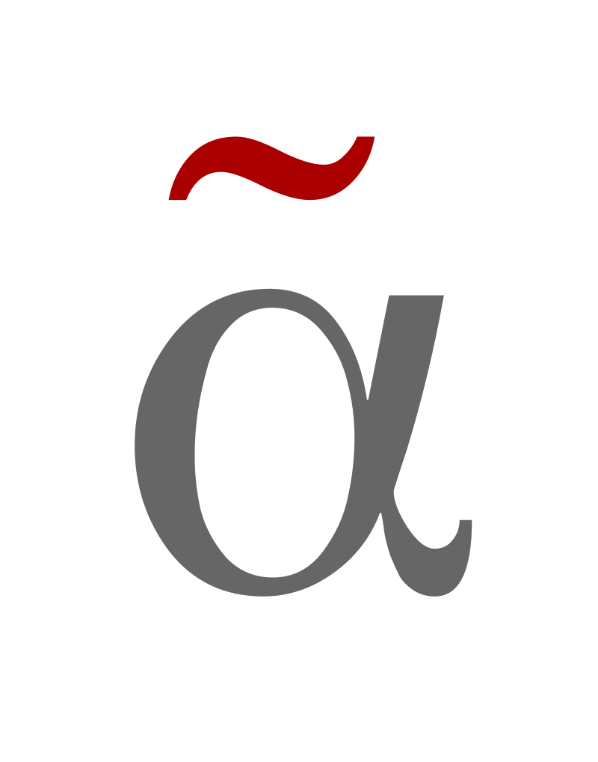
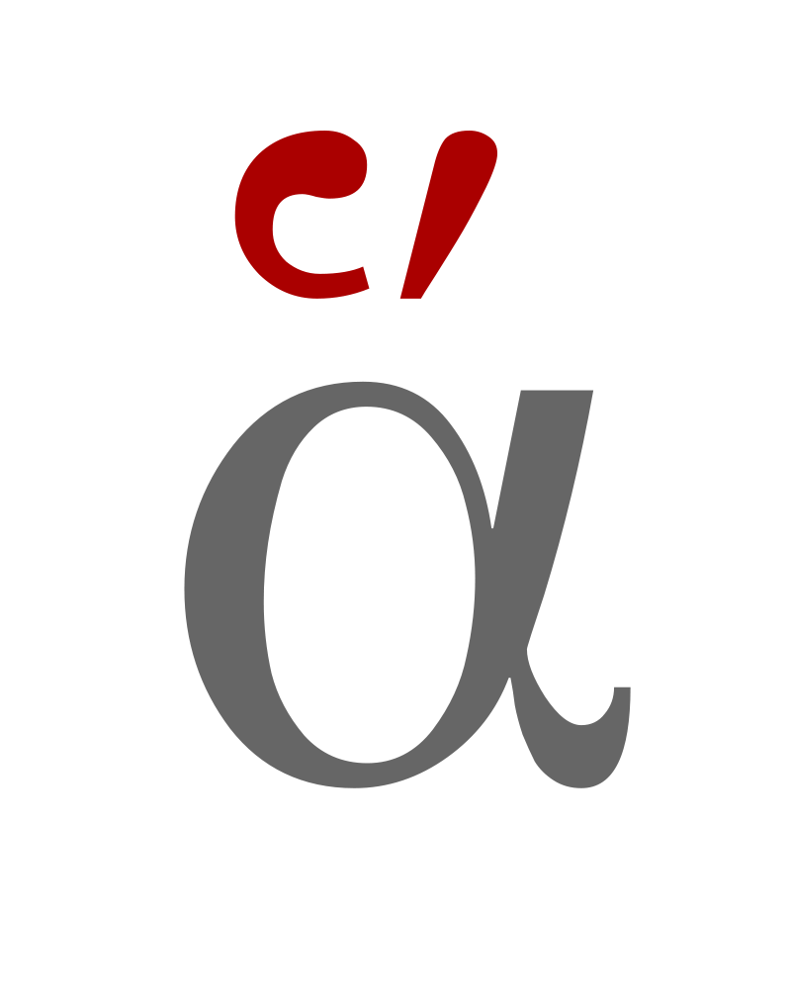
SOME HISTORY
Hellenistic Period (323 BC – 30 BC) → Introduction of diacritics
Byzantine Period (foundation of Constantinople, 330 AD – Ottoman conquer of Constantinople, 1453 AD) → Polytonic System, decay of uncial (capital) script
Modern Greek (GRE1001) | Jacopo Mosesso | VIT University, July 2022

Slide 8
SOME HISTORY
Ottoman rule: until 1832
1981: Monotonic System: ONLY ACUTE ACCENT AND ΔΙΑΛΥΤΙΚΑ: ά, έ, ή, ί, ό, ώ, ϊ, ΐ, ϋ
Modern Greek (GRE1001) | Jacopo Mosesso | VIT University, July 2022

Slide 9
τσάι /ˈtsai/ OR /tse/
χαϊδεμένος /xaiðeˈmenos/ OR /xedeˈmenos/
φαΐ /faˈi/ OR /fe/
αϋπνία /aiˈpnia/ OR /afˈpnia/
γαϊδούρι /ɣaiˈðuri/ OR /ˈɣeðuri /
Modern Greek (GRE1001) | Jacopo Mosesso | VIT University, July 2022

Slide 10
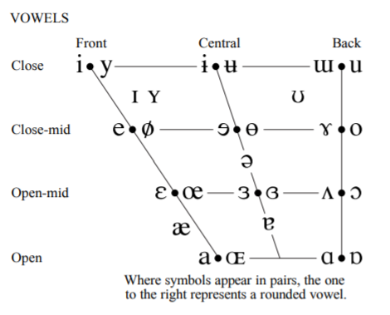
SINGLE AND DOUBLE VOWELS
α
η ι υ ει οι
ε αι
ο ω
ου
Modern Greek (GRE1001) | Jacopo Mosesso | VIT University, July 2022

Slide 11
SPURIOUS DIPHTHONGS
άι αη
όι οη
νεράιδα αηδόνι
κορόιδο βόηθα
Modern Greek (GRE1001) | Jacopo Mosesso | VIT University, July 2022

Slide 12
COMBINATIONS
αυ ευ + voiceless
αυ ευ + sonorant
αυτό ευχαριστώ
αυγά ευαίσθητη
Modern Greek (GRE1001) | Jacopo Mosesso | VIT University, July 2022

Slide 13
MONOTONIC SYSTEM
Greek words can only be stressed on one of the last three syllables;
the acute accent ◌́ is called τόνος and indicates which syllable is stressed in a word;
the acute accent is not written over one-syllable words, except for question words πού, πώς, the conjunction ή and preposition ώς;
the acute accent is not written over UPPERCASE text, except for those words that start with an accented vowel.
E.g.: άδεια -> 'ΑΔΕΙΑ -> in these cases the accented vowel is in word-initial position and when the same is written in uppercase, the accent can be found next to the vowel, before it (on its left) and not above it;
Modern Greek (GRE1001) | Jacopo Mosesso | VIT University, July 2022

Slide 14
MONOTONIC SYSTEM
when the stressed syllable is one of the double vowels αι, ου, ει, οι, υι or one of the combinations αυ or ευ, the acute accent is written over the second letter of the combination (e.g.: είναι, εύκολο);
if the acute accent is οn the first of two consecutive vowels (vowel digraphs, diphthongs, combinations), this indicates that the vowels are pronounced separately (e.g.: ρολόι, Κάιρο)
the diaeresis ̈ is called διαλυτικά and is used to indicate that the two vowels of an unstressed vowel digraph or combination are pronounced separately (e.g.: χαϊδεύω, τρόλεϊ, λαϊκή).
Modern Greek (GRE1001) | Jacopo Mosesso | VIT University, July 2022

Slide 15
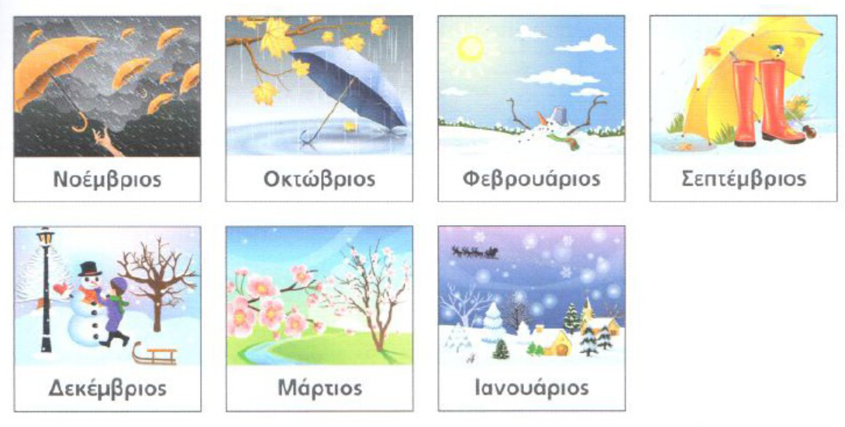
[v] Β, β
Νοέμβριος
Οκτώβριος
Φεβρουάριος
Σεπτέμβριος
Δεκέμβριος
Μάρτιος
Ιανουάριος
Modern Greek (GRE1001) | Jacopo Mosesso | VIT University, July 2022

Slide 16
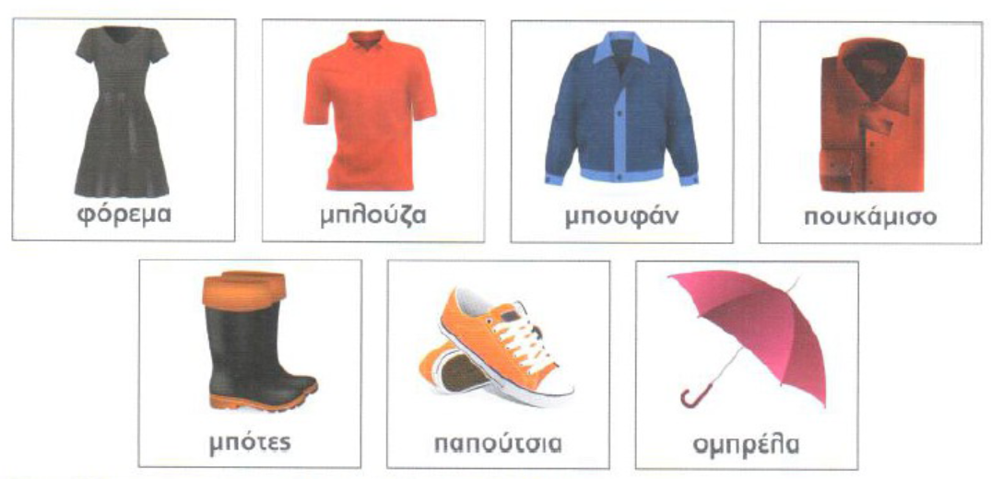
[(m)b] μπ
φόρεμα
μπλούζα
μπουφάν
πουκάμισο
μπότες
παπούτσια
ομπρέλα
Modern Greek (GRE1001) | Jacopo Mosesso | VIT University, July 2022

Slide 17
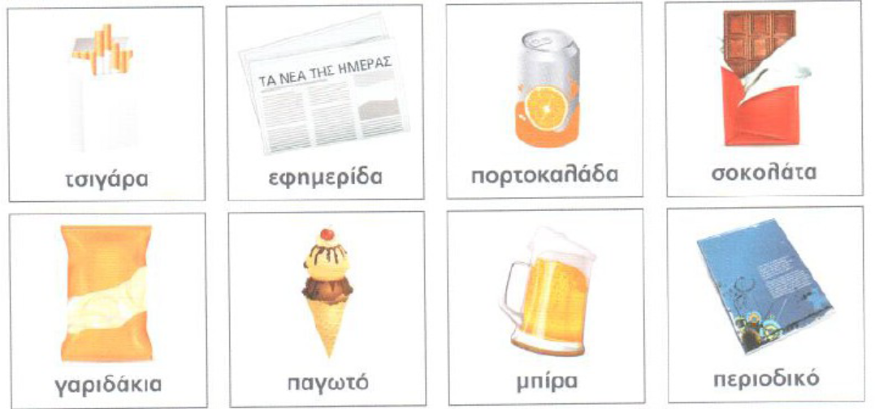
[ð] Δ, δ
τσιγάρα
εφημερίδα
πορτοκαλάδα
σοκολάτα
γαριδάκια
παγωτό
μπίρα
περιοδικό
Modern Greek (GRE1001) | Jacopo Mosesso | VIT University, July 2022

Slide 18
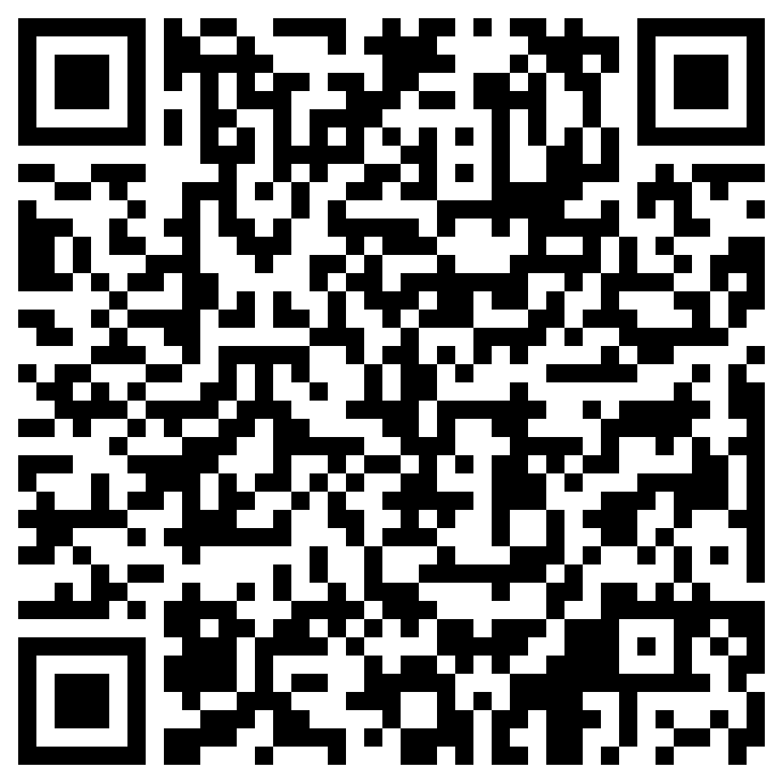
Modern Greek (GRE1001) | Jacopo Mosesso | VIT University, July 2022

